Slide 2
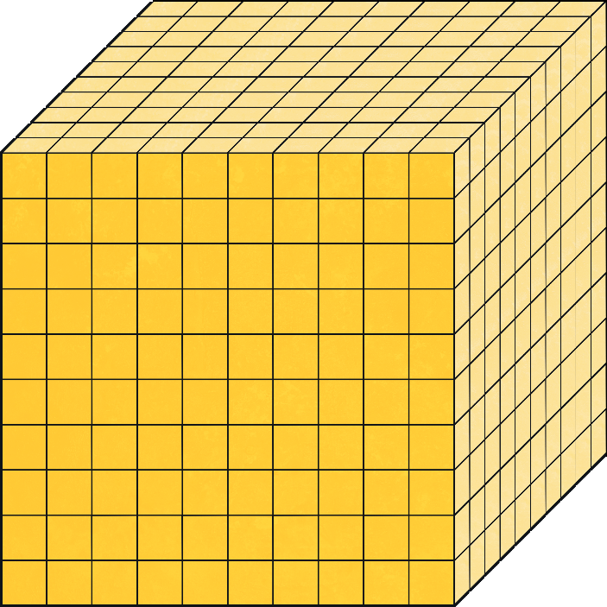
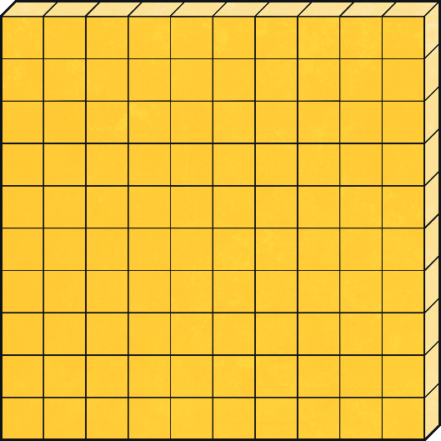
How much is a thousand?
A thousand is ten hundreds.
× 10 =

Slide 3
How much is ten thousand?
Ten thousand is ten thousands.
× 10

Slide 4
How much is a hundred thousand?
A hundred thousand is one hundred thousands.
× 100

Slide 5
How much is a million?
A million is one thousand thousands.
× 1000

Slide 6
What is the number?
M | HTh | TTh | Th | H | T | O
2
3
1
2
2
1
1
two million, three hundred and twelve thousand, two hundred and eleven
Answer
Words

Slide 7
What is the number?
M | HTh | TTh | Th | H | T | O
3
4
2
3
1
2
4
three million, four hundred and twenty-three thousand, one hundred and twenty-four
Answer
Words

Slide 8
What is the number?
M | HTh | TTh | Th | H | T | O
1
4
5
4
5
3
5
one million, four hundred and fifty-four thousand, five hundred and thirty-five
Answer
Words

Slide 9
What is the number?
M | HTh | TTh | Th | H | T | O
4
3
9
5
8
7
6
four million, three hundred and ninety-five thousand, eight hundred and seventy-six
Answer
Words

Slide 10
What is the number?
M | HTh | TTh | Th | H | T | O
1
5
7
7
0
2
1
one million, five hundred and seventy-seven thousand and twenty-one
Answer
Words

Slide 11
What is the number?
M | HTh | TTh | Th | H | T | O
2
0
0
8
5
4
5
two million, eight thousand, five hundred and forty-five
Answer
Words

Slide 12
What is the number?
M | HTh | TTh | Th | H | T | O
2
9
9
7
0
2
9
two million, nine hundred and ninety-seven thousand and twenty-nine
Answer
Words

Slide 13
What is the number?
M | HTh | TTh | Th | H | T | O
5
2
0
3
0
4
8
five million, two hundred and three thousand and forty-eight
Answer
Words

